Slide 1
Chatbot Development
Session 1 IBM Watson Assistant
Session 2
Python - Jupyter Notebook

Slide 2
Contents
Session 1
Session 2
Demo
Watson Assistant – Backend
Minimal Sketch
Extended Sketch
Components
Skill, Intent, Entity, Dialog
Context
Handson
Jupyter notebook for python
Python Libraties
Required components
Watson Library
URL
API Key
Skill ID
Request
Response
Context
External Services to call

Slide 3
Demo
https://github.com/IBM/watson-assistant-multi-bot-agent
https://github.com/cloudacademy/static-website-example
Notes:
https://github.com/IBM/watson-assistant-multi-bot-agent
https://github.com/cloudacademy/static-website-example

Slide 4
IBM Watson Assistant
offering for building conversational interfaces into any application, device, or channel.
knows
when to search for an answer from a knowledge base
when to ask for clarity
when to direct you to a human
Cloud service, allowing businesses to bring AI to their data and apps wherever they are

Slide 5
Minimum sketch
User
Watson Assistant
Workspace
Intent
Entity
Dialog
Intent
Entity
Dialog
Human
Intent
Entity
Dialog
Skill

Slide 6
Extended sketch
User
Interface
Supporting Services
Watson Assistant
Back-end Systems
Human
Slack
Team
Android
Web
Desktop
Speech to Text
Workspace
Services
Intent
Entity
Dialog
Intent
Entity
Dialog
Human
Intent
Entity
Dialog
Agent
Skill
Text to Speech
Services

Slide 7
Lets focus on Watson Assistant
User
Watson Assistant
Workspace
Intent
Entity
Dialog
Intent
Entity
Dialog
Human
Intent
Entity
Dialog
Skill

Slide 8
Skill
User
Watson Assistant
Users converse with skills
reusable program that contains capability in a specific domain.
examples:
weather forecasts
controlling IOT devices
customer care
Key artifacts of a skill
Intents
Entities
Dialog
Workspace
Intent
Entity
Dialog
Intent
Entity
Dialog
Human
Intent
Entity
Dialog
Skill

Slide 9
Intent
User
Watson Assistant
Intent
The goal of asking question
#Order
Can you take my order for breakfast
I would like to have soup
I want tea
Give me a coffee
Need some orange juice
#Bill
How much is my bill
What is my bill
How much do I pay
Bill please
Let me know my bill please
Workspace
Intent
Entity
Dialog
Intent
Entity
Dialog
Human
Intent
Entity
Dialog
Skill

Slide 10
Entity
User
Watson Assistant
Intent
The goal of asking question
#Order
Can you take my order for breakfast
I would like to have soup
I want tea
Give me a coffee
Need some orange juice
#Bill
How much is my bill
What is my bill
How much do I pay
Bill please
Let me know my bill please
Workspace
Intent
Entity
Dialog
Intent
Entity
Dialog
Human
Intent
Entity
Dialog
Skill

Slide 11
Entity
User
Watson Assistant
Intent
The goal of asking question
#Order
Can you take my order for breakfast
I would like to have soup
I want tea
Give me a coffee
Need some orange juice
#Bill
How much is my bill
What is my bill
How much do I pay
Bill please
Let me know my bill please
Entity
@item
breakfast
soup
tea
coffee
orange juice
Workspace
Intent
Entity
Dialog
Intent
Entity
Dialog
Human
Intent
Entity
Dialog
Skill

Slide 12
Dialog
Intents
#Order
Can you take my order for breakfast
I would like to have soup
I want tea
Give me a coffee
Need some orange juice
#Bill
How much is my bill
What is my bill
How much do I pay
Bill please
Let me know my bill please
welcome
Hello. How can I help you?
User
Watson Assistant
#Order
Sure. Your order has been taken. Let me serve you in a while.
Workspace
Intent
Entity
Dialog
Intent
Entity
Dialog
Human
Intent
Entity
Dialog
Skill
#Bill
Your bill is $amount
Entity
@item
breakfast
soup
tea
coffee
orange juice
anything else
I didn't get your meaning.

Slide 13
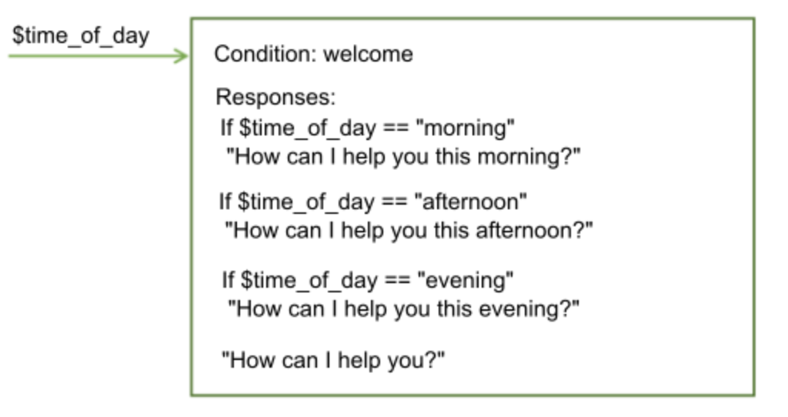
Context
The dialog in a dialog skill is stateless
does not retain information from one interaction with the user to the next
context variable
condition against context variable values

Slide 14
Summary
Watson Assistant Service
Skill
Intents
welcome
#Order
- Need tea
- Take my order please
- Can you get me a tea
#Bill
- How much do I pay
- Bill please
- What is payable amount
Hello. How can I help you?
#Order
Sure. Your order has been taken. Let me serve you in a while.
User
Entity
#Bill
@item
- soup
- tea
- coffee
- juice
Your bill is $amount
anything else
I didn't get your meaning.

